Slide 1
1: time consuming between different models in cpu
2: accuracy between different models
3: increase training data size will get positive result
4; perform physical constraint will get positive result
5 How gpu performance in different model
6 The model will have better result in more complexed case (more material mixture)
7 how accumulate error impact model performance

Slide 2
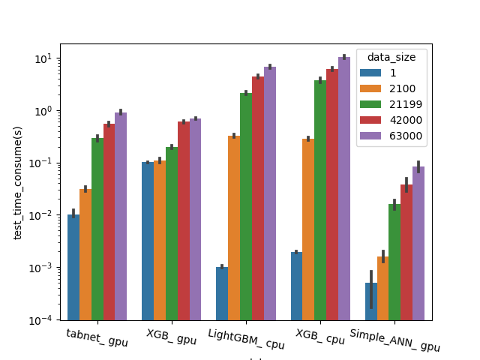
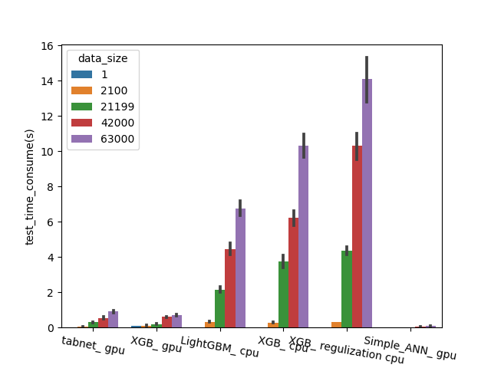
Test time with exponential increased y_axis
Test time with uniform increased y_axis

Slide 3
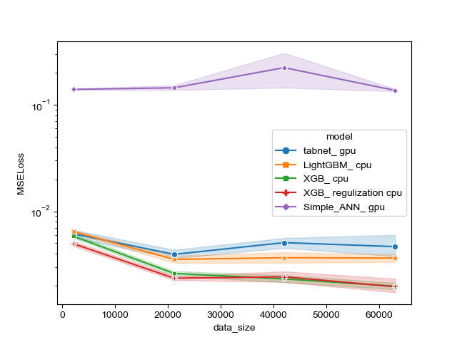
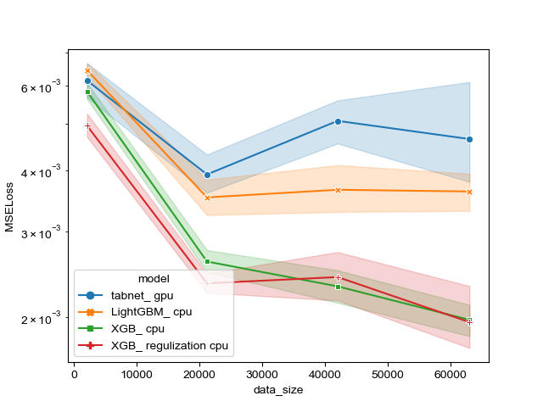
Error with simple_ANN
Error without simple_ANN

Slide 4
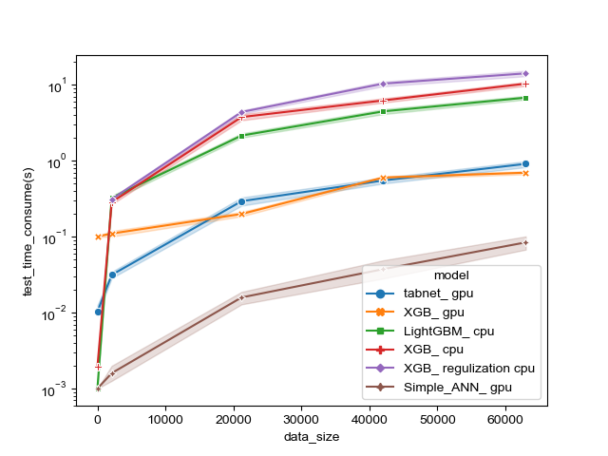
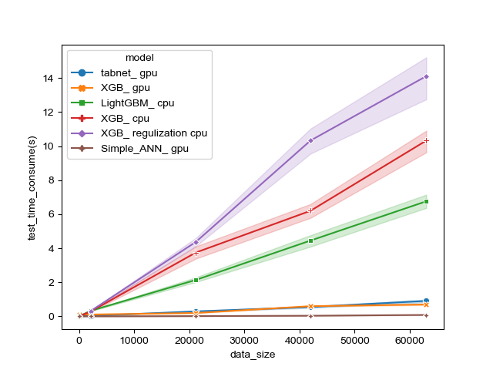
Test time with exponential increased y_axis
Test time with uniform increased y_axis

Slide 5
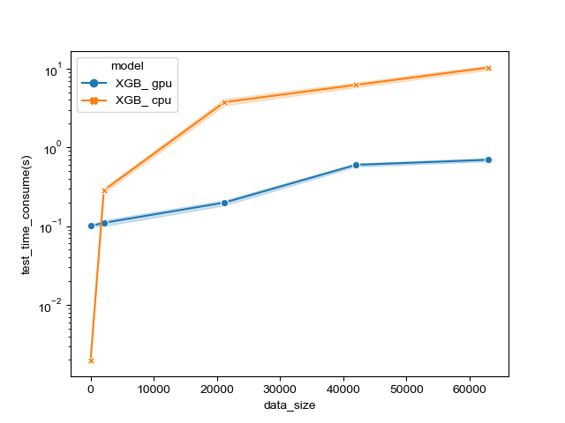
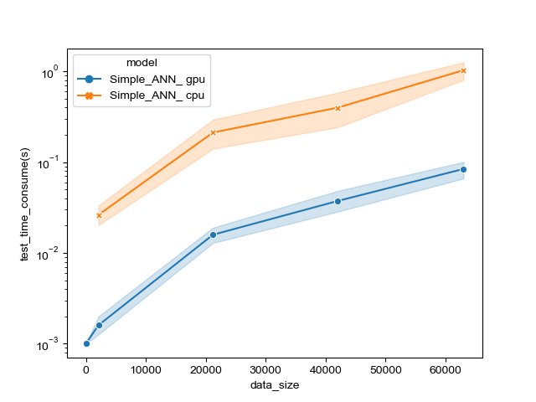
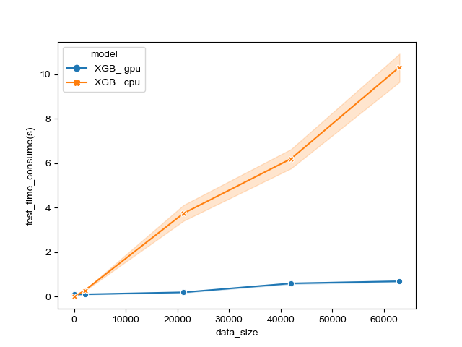
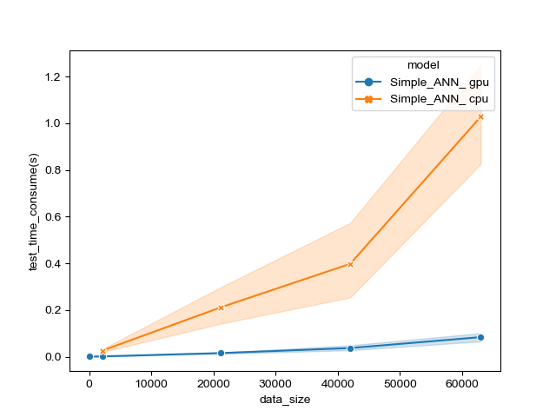
How GPU accelerate test time,( I find I don’t have tabnet in cpu, I will do it in the next week)

